Slide 1

Welcome!
Sunday
  Worship 9:30 AM
Sunday
  Bible Class (Livestream) 5:00 PM
Wednesday
  Bible Class (Livestream) 7:00 PM
www.SunsetchurchofChrist.net

Slide 2

Order of Service
Opening Prayer | Terry Petsche
Song – | Craig Foster
Song – | Craig Foster
Lord’s Supper | Rob Wade
Song – | Craig Foster
Lesson | Brian Haines
Song – | Craig Foster
Closing | Gregor Hinckley
Colossians 3:16
Let the word of Christ dwell in you richly in all wisdom, teaching and admonishing one another in psalms and hymns and spiritual songs, singing with grace in your hearts to the Lord.

Slide 3
Notes:
A local man in town brought in a couple of men who were intent on harassing others and spreading their prejudice. Some of the more conscientious people in town stood up to the local man and demanded justice. Where would you stand?
A man was convicted of lying to people and pretending to be a known religious leader to get people to follow him. He was finally arrested and

Slide 4
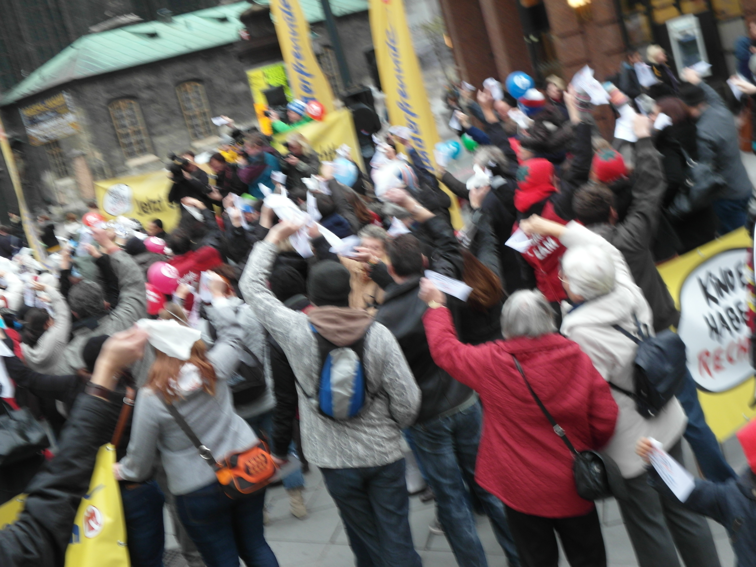
The Crowd
Matthew 27:20-25
Acts 2:23-36
Notes:
Were the Jews who killed Christ vicious haters? In fact, some were his followers!
Joh 8:31 ¶ Then Jesus said to those Jews who believed Him, "If you abide in My word, you are My disciples indeed……… 37 "I know that you are Abraham's descendants, but you seek to kill Me, because My word has no place in you.
Joh 6:66 From that time many of His disciples went back and walked with Him no more.

Slide 5
God’s Warning
"You shall not circulate a false report. Do not put your hand with the wicked to be an unrighteous witness. You shall not follow a crowd to do evil; nor shall you testify in a dispute so as to turn aside after many to pervert justice.” Exodus 23:1-2

Slide 6
God’s Warning
"You shall not circulate a false report. Do not put your hand with the wicked to be an unrighteous witness. You shall not follow a crowd to do evil; nor shall you testify in a dispute so as to turn aside after many to pervert justice.” Exodus 23:1-2

Slide 7
God HATES Mob Mentality
These six things the LORD hates, Yes, seven are an abomination to Him: a proud look, a lying tongue, Hands that shed innocent blood, a heart that devises wicked plans, feet that are swift in running to evil, a false witness who speaks lies, and one who sows discord among brethren. Proverbs 6:16-17
Notes:
Mob mentality, also called as herd mentality, describes how humans adopt behaviors, buy merchandise, and follow trends based on their circle of influence. It explains how one's point of view can be easily altered by those around them

Slide 8
God HATES Mob Mentality
It pushes emotion over reason
Anger – James 1:20
Indignation – Acts 5:17
Mobs needs action without thought
Notes:
Jas 1:20 for the wrath of man does not produce the righteousness of God.
Ac 5:17 ¶ Then the high priest rose up, and all those who were with him (which is the sect of the Sadducees), and they were filled with indignation,
Mr 10:41 Hearing this, the ten began to feel indignant with James and John.

Slide 9
God HATES Mob Mentality
It pushes emotion over reason
It creates good guys and bad guys
Enmity – Galatians 5:20
Hatred – Acts 7:57-60
Mobs manufacture outrage
Notes:
Ga 5:20 idolatry, sorcery, hatred, contentions, jealousies, outbursts of wrath, selfish ambitions, dissensions, heresies,
Ac 7:57 Then they cried out with a loud voice, stopped their ears, and ran at him with one accord; 58 and they cast him out of the city and stoned him. And the witnesses laid down their clothes at the feet of a young man named Saul. 59 And they stoned Stephen as he was calling on God and saying, "Lord Jesus, receive my spirit." 60 Then he knelt down and cried out with a loud voice, "Lord, do not charge them with this sin." And when he had said this, he fell asleep.

Slide 10
God HATES Mob Mentality
It pushes emotion over reason
It creates good guys and bad guys
It results in evil behavior
Digression to murder – Romans 1:22-29
Notes:
Ga 5:20 idolatry, sorcery, hatred, contentions, jealousies, outbursts of wrath, selfish ambitions, dissensions, heresies,
Ac 7:57 Then they cried out with a loud voice, stopped their ears, and ran at him with one accord; 58 and they cast him out of the city and stoned him. And the witnesses laid down their clothes at the feet of a young man named Saul. 59 And they stoned Stephen as he was calling on God and saying, "Lord Jesus, receive my spirit." 60 Then he knelt down and cried out with a loud voice, "Lord, do not charge them with this sin." And when he had said this, he fell asleep.

Slide 11
Mob Mentality
Are you guilty of a mob mentality?
Do you follow the crowd:
In support or rejection of the latest fad
Fearful of appearing out of touch
Wanting to seem aware of society
Notes:
Many of us are quick to share posts that we think need to shake people up

Slide 12
Peter Addresses the Mob
Acts 2:23-36
Their guilt:
- Lawless hands
- Murder (Acts 5:30)
Point: A mob shares guilt joint and several

Slide 13
The Christ-like Mentality
Right and wrong apart from the world
1 John 2:15-17
Notes:
1Jo 2:15 Do not love the world or the things in the world. If anyone loves the world, the love of the Father is not in him. 16 For all that is in the world--the lust of the flesh, the lust of the eyes, and the pride of life--is not of the Father but is of the world. 17 And the world is passing away, and the lust of it; but he who does the will of God abides forever.

Slide 14
The Christ-like Mentality
Right and wrong apart from the world
The Berean attitude in our opinions
Acts 17:10-11
Notes:
Ac 17:10 ¶ Then the brethren immediately sent Paul and Silas away by night to Berea. When they arrived, they went into the synagogue of the Jews. 11 These were more fair-minded than those in Thessalonica, in that they received the word with all readiness, and searched the Scriptures daily to find out whether these things were so.

Slide 15
The Christ-like Mentality
Right and wrong apart from the world
The Berean attitude in our opinions
Testing the spirits
1 John 4:1
Notes:
1Jo 4:1 ¶ Beloved, do not believe every spirit, but test the spirits to see whether they are from God, because many false prophets have gone out into the world.

Slide 16
The Christ-like Mentality
Christians will not be in the mob
We believe Christ is the answer
We live at peace with all men
Notes:
1Jo 4:1 ¶ Beloved, do not believe every spirit, but test the spirits to see whether they are from God, because many false prophets have gone out into the world.

Slide 18
God’s Admonition to Man
Believes – John 6:29
Confesses – Matthew 10:32
Repents – Matthew 4:17
Submits to baptism – Mark 16:16
Remains faithful – Matthew 24:13

